Slide 1
I/O Techniques

Slide 2
Input Output Techniques
• Programmed I/O
• Interrupt driven I/O
• Direct Memory Access (DMA)

Slide 3
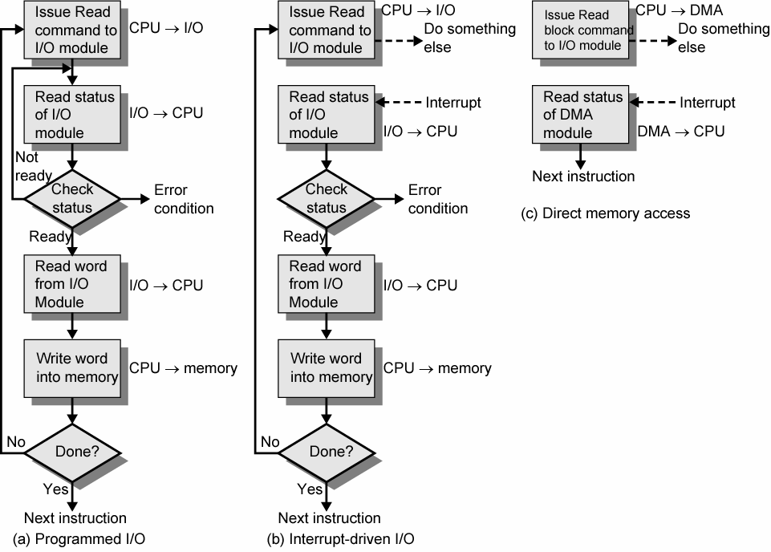
Input Output Techniques

Slide 4
Programmed I/O
• CPU has direct control over I/O
– Sensing status
– Read/write commands
– Transferring data
• CPU waits for I/O module to complete operation
• Wastes CPU time

Slide 5
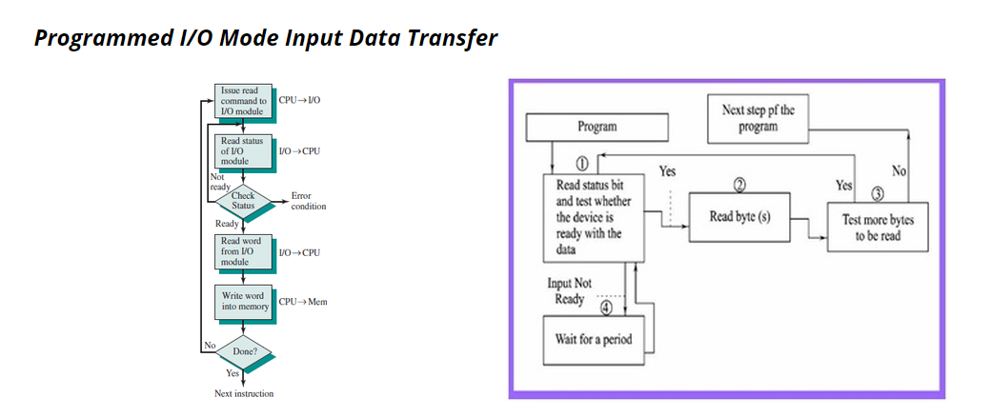

Slide 6
Programmed I/O
• CPU requests I/O operation.
• I/O module performs operation and sets status bits after completion.
• CPU checks status bits periodically.
• I/O module does not inform CPU directly that is it does not interrupt CPU.
• CPU must wait.

Slide 7
Interrupt Driven I/O
• Overcomes CPU waiting
• No repeated CPU checking of device
• I/O module interrupts when ready

Slide 8
Interrupt
An interrupt is a signal from a device attached to a computer or from a program within the computer that causes the CPU to stop its normal program execution and perform service related to the event.
Examples of interrupts :I/O completion, divide-by-0, etc.
Maskable Interrupt: It is a hardware interrupt that may be ignored by setting a bit in an interrupt mask register's (IMR) bit-mask.
Non-maskable Interrupt: is a hardware interrupt that does not have a bit-mask associated with it - meaning that it can never be ignored. NMIs are often used for timers, especially watchdog timers

Slide 9
Interrupt-Initiated I/O
When the interface determines that the I/O device is ready for data transfer, it generates an Interrupt Request to the CPU .
Upon detecting an interrupt, CPU stops momentarily the task it is doing, branches to the service routine to process the data transfer, and then returns to the task it was performing

Slide 10
Interrupt Driven I/O Basic Operation
• CPU issues read command
• I/O module gets data from peripheral while CPU does other work
• I/O module interrupts CPU after completion
• CPU requests data
• I/O module transfers data

Slide 11
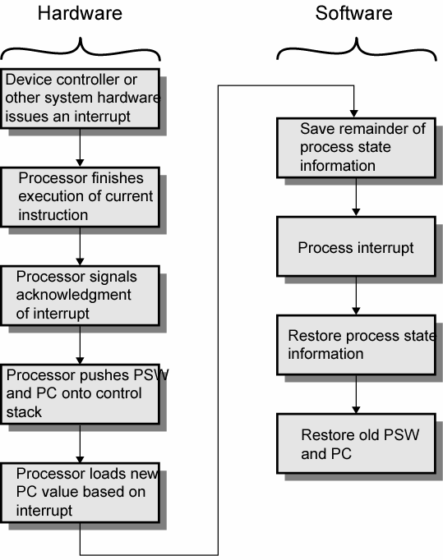
Simple Interrupt Processing

Slide 12
CPU Viewpoint
• Issue read command
• Do other work
• Check for interrupt at end of each instruction cycle
• If interrupted:-
– Save context (registers)
– Process interrupt
• Fetch data & store

Slide 13
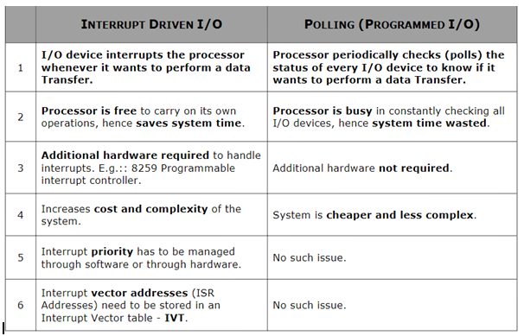

Slide 14
DMA

Slide 15
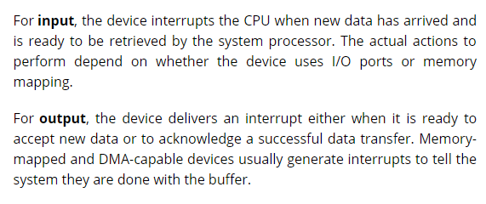

Slide 16
2 methods in which the CPU chooses the branch address of the service routine
Non-vectored interrupt
Branch address is assigned to a fixed location
User has to provide address of subroutine using a CALL instruction
Vectored interrupt
Interrupt supplies the branch info (direct or indirect address of ISR) to the CPU
Processor automatically generates the subroutine address

Slide 17
Priority Interrupt
Establishes priority over the various sources to determine which condition is to be serviced first when two or more requests arrive simultaneously.
The system may also determine which conditions are permitted to interrupt the computer while another interrupt is being serviced.
Priority can be established by software or hardware

Slide 18
Polling-S/W
Software Priority – polling – common branch address for all interrupts. Program to perform the test will be stored in this common branch address.
Highest priority source is tested first and if its interrupt signal is on, control branches to a service routine for this source.
Otherwise, the next-lower priority source is tested and so on.
Disadvantage – if many interrupts, time required to poll them may exceed the time available to service the I/O device.

Slide 19
Vectored Interrupts-H/W
Then, hardware priority interrupt unit can be used to speed up the operation.
Hardware priority interrupts – accepts interrupt request from many sources, determines which of the incoming requests has the highest priority and issues an interrupt request to the computer.
Here, each interrupt source has its own interrupt vector to access its own service routine directly.
Hardware priority interrupts – Serial or Parallel connection of interrupt lines.

Slide 20
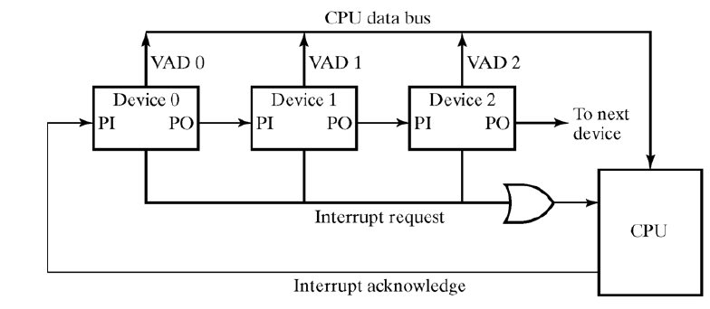
Serial - Daisy chaining
Serial hardware priority function
* Interrupt Request Line
- Single common line
* Interrupt Acknowledge Line
- Daisy-Chain

Slide 21
Parallel Priority Interrupt
Uses a register whose bits are set separately by the interrupt signal from each device.
Priority is established according to the position of the bits in the register.
Mask register is used to disable lower priority interrupts while a higher priority device is being serviced.
It can also provide a facility that allows a high-priority device to interrupt the CPU while a lower priority device is being serviced

Slide 22
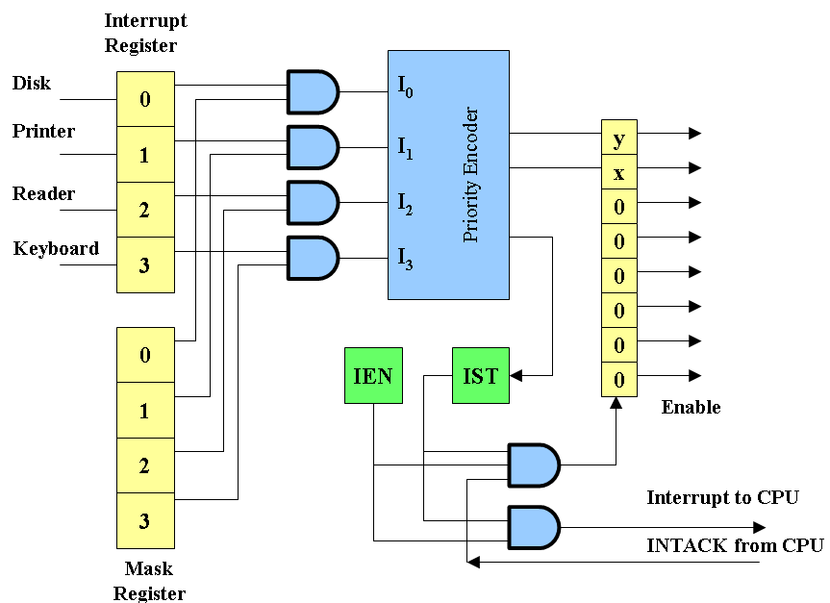
Mask register has a same number of bits as the interrupt register.
By means of program instructions, it is possible to set or reset any bit in the mask register.

Slide 23
The priority encoder generates two bits of the vector address, which is transferred to the CPU.
Another output from the encoder sets an interrupt status flip-flop IST when an interrupt that is not masked occurs.
The interrupt enable flip-flop IEN can be set or cleared by the program to provide an overall control over the interrupt system.
IST ANDed with IEN provide a common interrupt signal for the CPU.
The INTACK signal from the CPU enables the bus buffers in the output register and a vector address VAD is placed into the data bus.

Slide 24
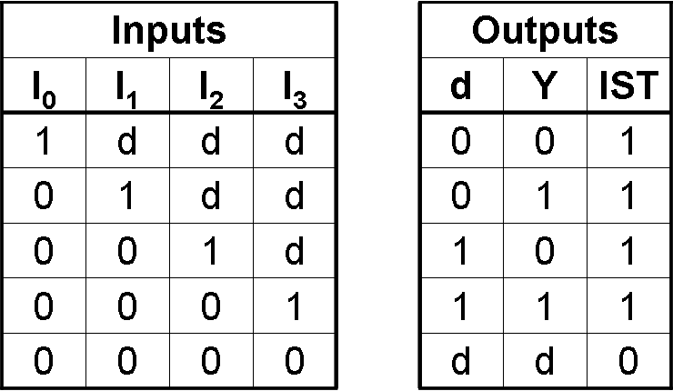
Priority encoder
Circuit that implements the priority function.
Logic – if two or more inputs arrive at the same time, the input having the highest priority will take precedence.
Boolean functions
X = I’₀I’₁ Y = I’₀I₁ + I’₀I’₂ IST = I₀ + I₁ + I₂ + I₃

Slide 25
Interrupt
An interrupt is a signal from a device attached to a computer or from a program within the computer that causes the CPU to stop its normal program execution and perform service related to the event.
Maskable Interrupt: It is a hardware interrupt that may be ignored by set/reset a bit in an interrupt mask register's (IMR) bit-mask.
Non-maskable Interrupt: is a hardware interrupt that does not have a bit-mask associated with it - meaning that it can never be ignored. NMIs are often used for timers, especially watchdog timers

Slide 26
Interrupt Cycle
The Interrupt enable flip-flop (IEN) can be set or cleared by program instructions.
A programmer can therefore allow interrupts (clear IEN) or disallow interrupts (set IEN)
At the end of each instruction cycle the CPU checks IEN and IST. If either is equal to zero, control continues with the next instruction. If both = 1, the interrupt is handled.
Interrupt micro-operations:
SP←SP – 1 (Decrement stack pointer)
M[SP] ← PC Push PC onto stack
INTACK ← 1 Enable interrupt acknowledge
PC ←VAD Transfer vector address to PC
IEN ←0 Disable further interrupts
Go to fetch next instruction

Slide 27
Interrupt Service Routine
An interrupt handler, also known as an interrupt service routine (ISR), is a callback subroutine in an operating system whose execution is triggered by the reception of an interrupt. Interrupt handlers have a multitude of functions, which vary based on the reason the interrupt was generated.
Interrupt Overhead
The interrupt overhead is caused by context switching (storing and restoring the state of CPU )
On interrupt handler entry, the context of the current process and its thread must be saved. On exit, it must be restored.
On handler entry, memory locations different from the memory locations in the cache are used, and therefore cache updates are required.

Slide 28
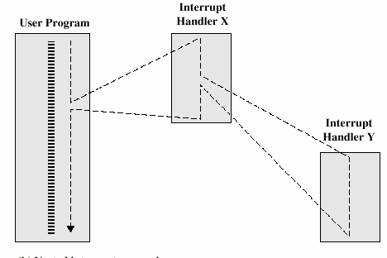
Interrupt nesting
An interrupt can happen while executing an ISR. This is called interrupt nesting.

Slide 29
Role of CPU in transfer of information
peripheral device -> CPU -> memory
CPU limits the speed of transfer
Peripheral device -> memory
Transfer speed increases
Peripheral device manage the memory bus directly.
DMA (Direct memory Access)
CPU is idle

Slide 30
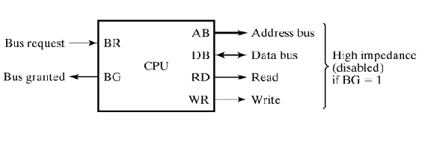
CPU Bus Signals for DMA Transfer
DMA Controller sends Bus Request to CPU
CPU stops execution of current instruction and places address bus, data bus, read and write lines into high impedance state.
CPU activates Bus Grant
After transfer DMA disables BR
CPU continues normal operation

Slide 31
Different ways of DMA transfer
Burst transfer – a block sequence consisting of a number of memory words is transferred in a continuous burst => need for fast devices
Cycle stealing – transfer one word at a time, after which it must return control of the buses to the CPU.
CPU delays 1 cycle to allow Direct Memory I/O transfer

Slide 32
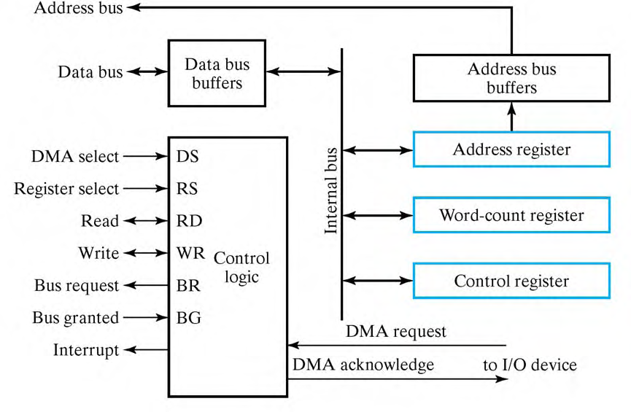
DMA Controller

Slide 33
DMA Controller contd.,
Three registers
Address registers – to specify the desired location in memory
Incremented after each word transfer
Word count registers – numbers of words to be transferred
Decremented after each word transfer and tested for 0.
Control register – specifies mode of transfer

Slide 34
DMA Controller
Data bus and control lines => used to communicate with CPU
Registers in DMA are selected by CPU through address bus by enabling DS and RS inputs.
BG = 0 => CPU reads from or writes to the DMA registers
BG = 1 => DMA directly communicates with Memory by specifying address in address bus and activates the RD or WR control.
Request and acknowledge signals are used to communicate with peripheral devices

Slide 35
Initialization of DMA
CPU initializes DMA by sending the following information through data bus
Starting address of the memory block where data are available (for read) or where data are to be stored (for write)
The word count
Control – to read or write
A control to start the DMA transfer
After initialization, CPU stops communicating with DMA unless it receives an interrupt signal or if it wants to checks how many words have been transferred.

Slide 36
DMA Transfer

Slide 37
DMA Transfer
Bus Request
Peripheral device ----------> DMA controller -----------> CPU -----------> DMA controller
DMA controller puts the current value of its address register onto address bus, activates RD or WR signal, and --------------> peripheral device
RD and WR are bidirectional
BG = 0 => CPU communicates with the internal DMA registers
BG = 1 => RD and WR are output lines from DMA controller to the RAM to specify read or write operation for data
DMA Request
Bus grant
DMA Acknowledge

Slide 38
DMA contd.,
When the peripheral device receives a DMA acknowledge, it puts a word onto data bus or receives a word from data bus
For each word transfer, DMA increments address register and decrements word count register.
If WC = 0, DMA disables Bus request.
Termination is informed to CPU by means of interrupt signal.
When CPU receives interrupt signal, it checks value of word count register.

Slide 39
Application
Fast transfer of information between magnetic disk and memory
Updating the display in an interactive terminal

